Slide 1
PC 15 | CRUD Operations
Manikandan.C

Slide 2
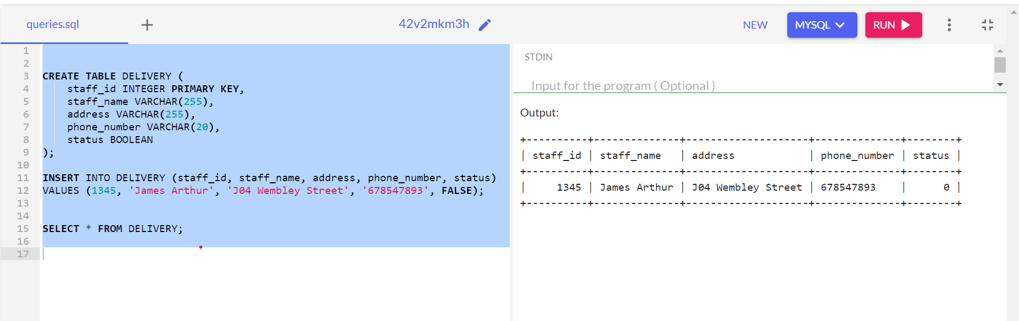
Insert in Delivery

Slide 3
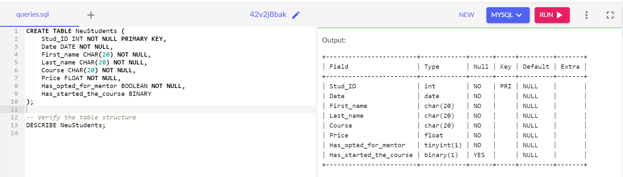
Create NeuStudents

Slide 4
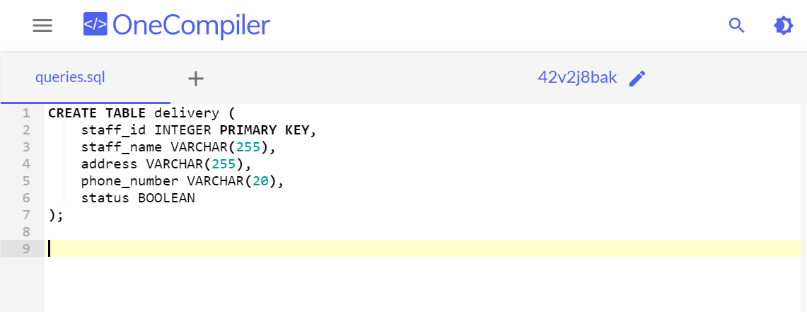
Create Delivery Table

Slide 5
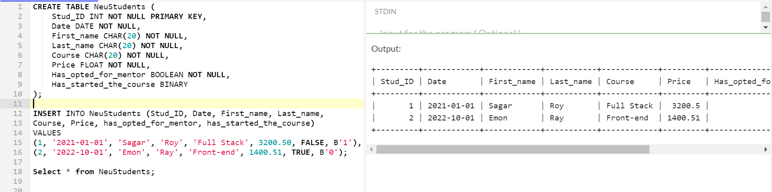
Insert NeuStudents

Slide 6
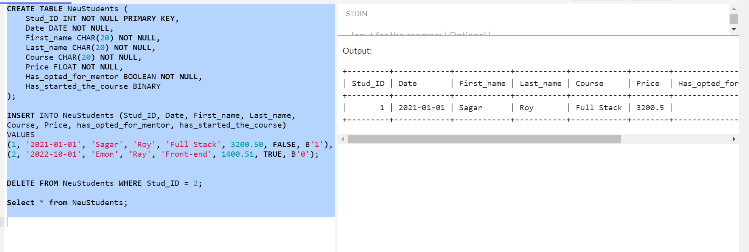
Delete from NeuStudents

Slide 7
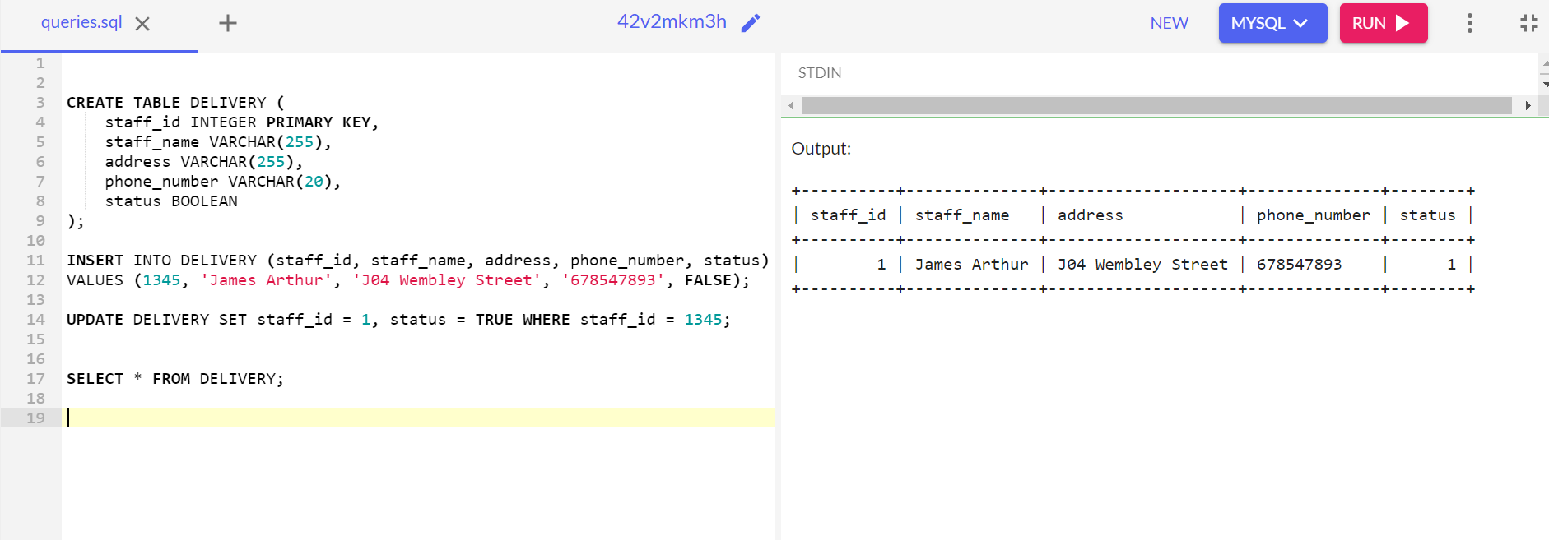
Update in Delivery

